Slide 1
Proper Hydration is a Critical Factor for a Healthy Lifestyle
Daily Water Intake

Slide 2
Topic of Study: What affects the amount of water intake I consume everyday?
General studies recommend that the daily intake should be 3 liters a day. Does workout play a factor in my consumption of water

Slide 3
Hypotheses
  Hypothesis 1:Null Hypothesis: Mean intake = 3000 mL/day
  Alternative Hypothesis: Mean intake ≠ 3000 mL/day
  If p-value < 0.05 we will reject the Null Hypothesis
  If p-value >0.05 we will fail to reject the Null Hypothesis.
  Hypothesis 2:Null Hypothesis : Mean intake on workout days = mean intake on non-workout days
  Alternative Hypothesis : Mean intake on workout days ≠ mean intake on non-workout days
  If p-value < 0.05 we will reject the Null Hypothesis
  If p-value >0.05 we will fail to reject the Null Hypothesis.

Slide 4
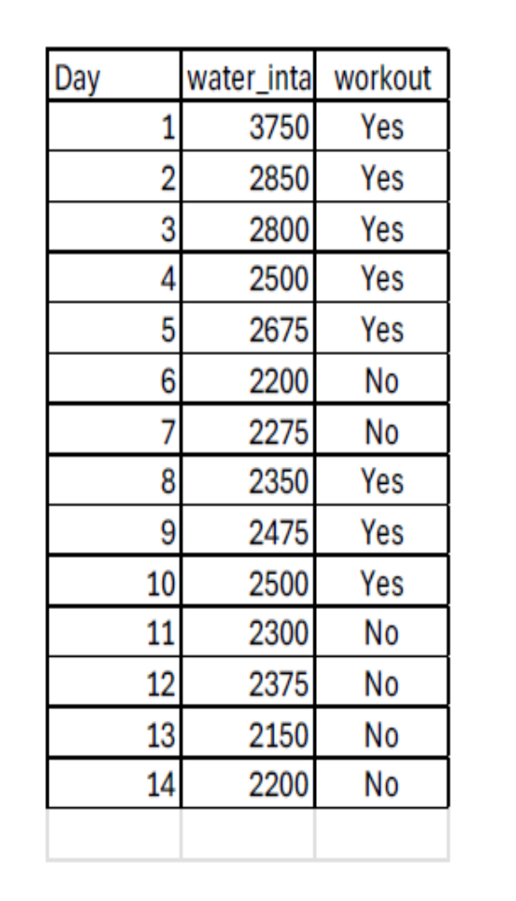
Data CollectionVariables
  Dependent Variable:Daily Water Intake (mL)
    Independent Variable:Workout statusYes/No
  Other Column:Day(identifier)

Slide 5
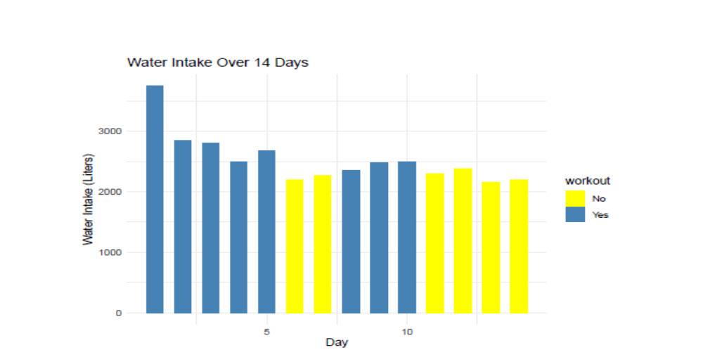
•Significance level•0.05
•One-Sample t-test•Mean intake = 2528.57 mL/day
•p-value = 7.083e-12. we reject H₀.
•Conclusion: Intake is significantly lower than 3 liters/day.
•Two-sample t-test:•Mean intake workout days = 2737.5
•Mean intake non-workout days = 2250
•p-value = 0.01699, we reject H₀.
•Conclusion: Intake is significantly higher on workout days

Slide 6
Slide 6: Conclusion & Implications
  Key findings:Average intake < recommended 3 liters/day.
  Workout status influences intake.
  Implications:Students may need to increase hydration.
  Workout days show different hydration intake.
  Future directions:Larger sample size
  Explore other factors (diet, weather, exercise intensity)
One Sample t-test
data: Daily_water_intake$water_intake
t = 22.836, df = 13, p-value = 7.083e-12
alternative hypothesis: true mean is not
equal to 3
95 percent confidence interval:
2289.646 2767.496
sample estimates:
mean of x
2528.571
Two Sample t-test
data: water_intake by workout
t = -3.0396, df = 7.6326, p-value = 0.01699
alternative hypothesis: true difference in
means between group No and group Yes is not
equal to 0
95 percent confidence interval:
-860.4695 -114.5305
sample estimates:
mean in group No mean in group Yes
2250.0 2737.5

Slide 7
Proper Hydration is a Critical Factor for a Healthy Lifestyle Daily Water Intake
Topic of Study: What affects the amount of water intake I consume everyday?
General studies recommend that the daily intake should be 3 liters a day. Does workout play a factor in my consumption of water?
Hypotheses
  Hypothesis 1:Null Hypothesis: Mean intake = 3000 mL/day
  Alternative Hypothesis: Mean intake ≠ 3000 mL/day
  If p-value < 0.05 we will reject the Null Hypothesis
  If p-value >0.05 we will fail to reject the Null Hypothesis.
  Hypothesis 2:Null Hypothesis : Mean intake on workout days = mean intake on non-workout days
  Alternative Hypothesis : Mean intake on workout days ≠ mean intake on non-workout days
  If p-value < 0.05 we will reject the Null Hypothesis
  If p-value >0.05 we will fail to reject the Null Hypothesis.
Data CollectionVariables
  Dependent Variable:Daily Water Intake (mL)
    Independent Variable:Workout statusYes/No
  Other Column:Day(identifier)
•Significance level•0.05
•One-Sample t-test•Mean intake = 2528.57 mL/day
•p-value = 7.083e-12. we reject H₀.
•Conclusion: Intake is significantly lower than 3 liters/day.
•Two-sample t-test:•Mean intake workout days = 2737.5
•Mean intake non-workout days = 2250
•p-value = 0.01699, we reject H₀.
•Conclusion: Intake is significantly higher on workout days
Slide 6: Conclusion & Implications
  Key findings:Average intake < recommended 3 liters/day.
  Workout status influences intake.
  Implications:Students may need to increase hydration.
  Workout days show different hydration intake.
  Future directions:Larger sample size
  Explore other factors (diet, weather, exercise intensity)
One Sample t-test
data: Daily_water_intake$water_intake
t = 22.836, df = 13, p-value = 7.083e-12
alternative hypothesis: true mean is not
equal to 3
95 percent confidence interval:
2289.646 2767.496
sample estimates:
mean of x
2528.571
Two Sample t-test
data: water_intake by workout
t = -3.0396, df = 7.6326, p-value = 0.01699
alternative hypothesis: true difference in
means between group No and group Yes is not
equal to 0
95 percent confidence interval:
-860.4695 -114.5305
sample estimates:
mean in group No mean in group Yes
2250.0 2737.5

